Slide 1


RBC
Bank Churn Analysis

Slide 2



RBC bank faces a persistent challenge of customer churn, leading to financial losses and decreased customer satisfaction. Understanding the factors that drive customers to leave is critical to devising strategies for customer retention.
Problem Statement

Slide 3
Objective :-
This project aims to:
Analyse customer churn data to identify key factors influencing customer attrition.
Provide actionable insights to help RBC Bank proactively target customers at risk of leaving, thereby improving retention efforts and reducing churn-related losses.
This project aims to analyse the customer churn rate for the bank because it is useful to understand why customers leave.
The analysis aims on identifying various KPIs such as Inactive customers, Retain Customers, Exit Customers, and the underlying patterns like previous month exit customers vs. current month exit customers, customers churn by credit type, customer churn by gender, churn %, customers by geographic location etc.

Slide 4
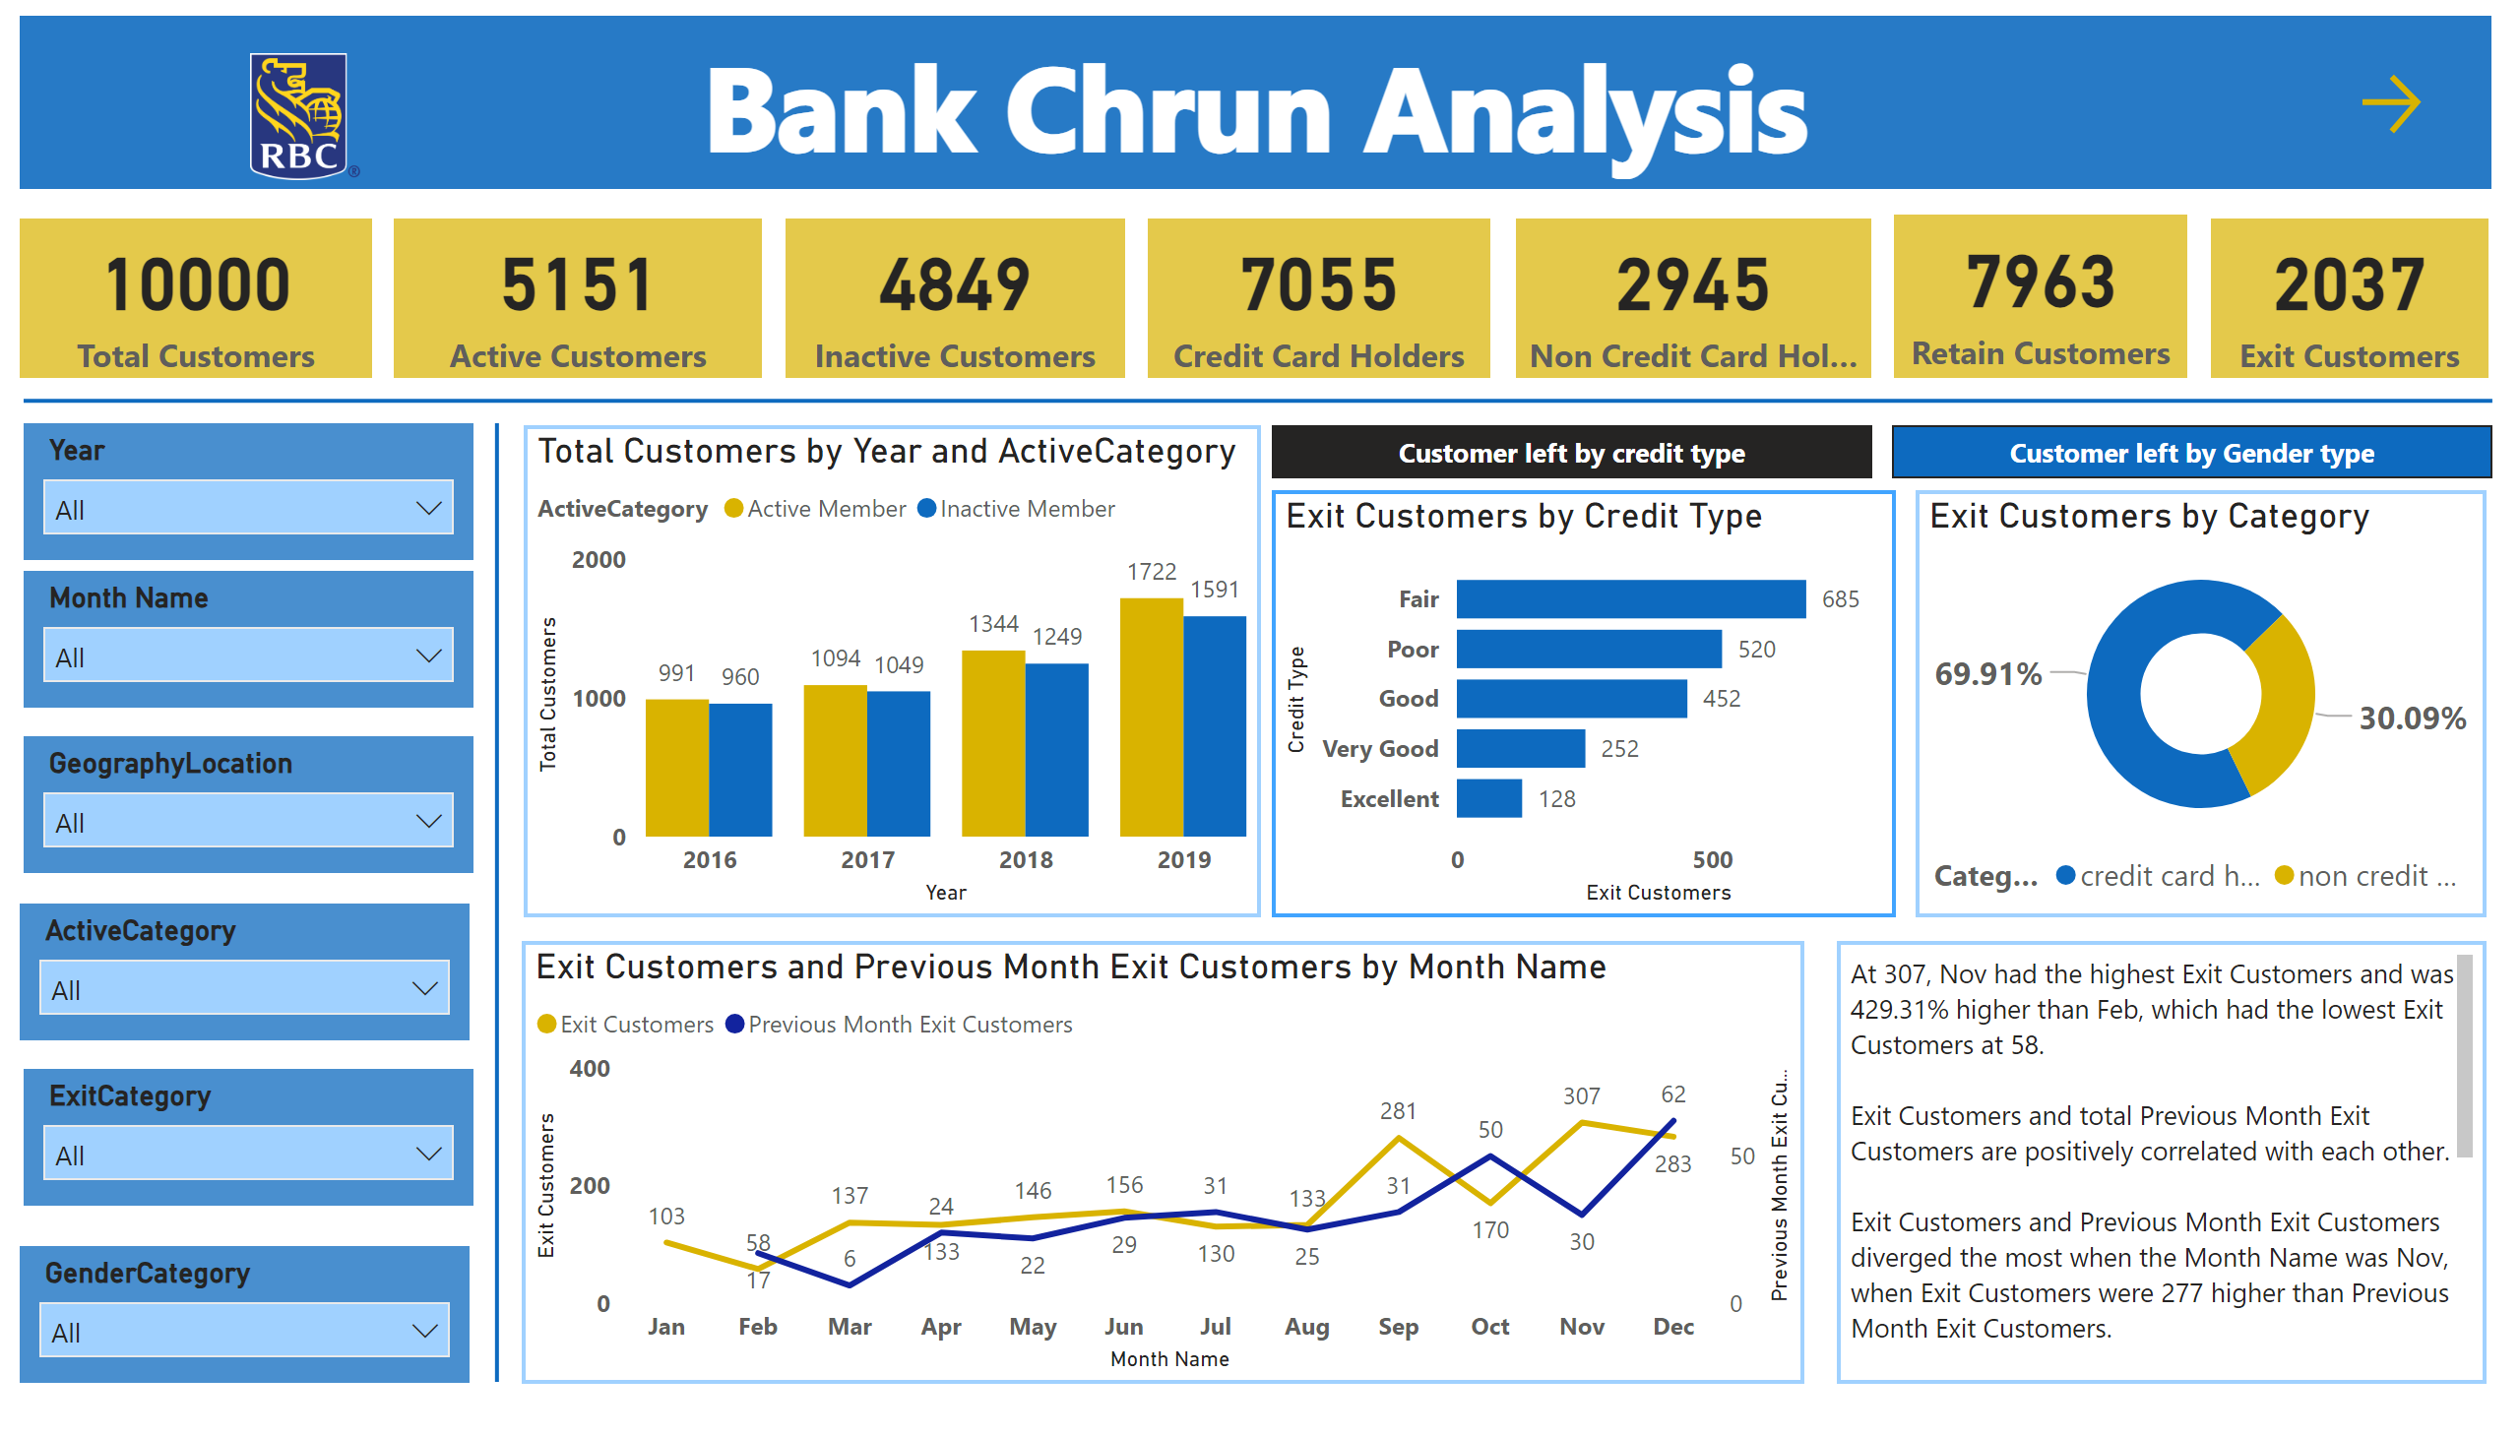
Homepage
Notes:
textbox
No alt text provided
textbox
No alt text provided
image
No alt text provided
card
No alt text provided
card
No alt text provided
card
No alt text provided
card
No alt text provided
card
No alt text provided
card
No alt text provided
card
No alt text provided
shape
No alt text provided
shape
No alt text provided
slicer
No alt text provided
slicer
No alt text provided
slicer
No alt text provided
slicer
No alt text provided
slicer
No alt text provided
slicer
No alt text provided
clusteredColumnChart
No alt text provided
donutChart
No alt text provided
barChart
No alt text provided
pieChart
No alt text provided
lineChart
No alt text provided
textbox
No alt text provided
actionButton
No alt text provided
bookmarkNavigator
No alt text provided

Slide 5
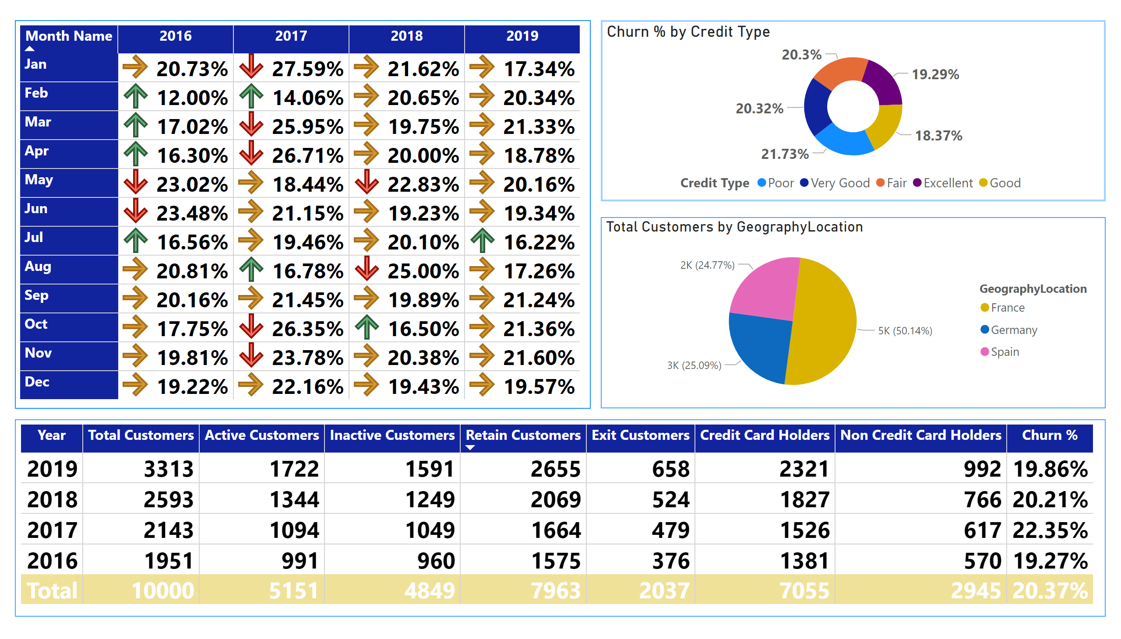
Churn %
Notes:
pivotTable
No alt text provided
pieChart
No alt text provided
tableEx
No alt text provided
donutChart
No alt text provided

Slide 6
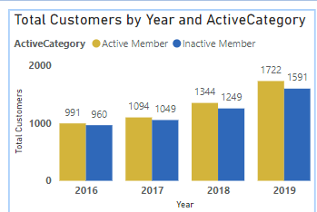
Total Customers by Year
Insight:
The number of active and inactive customers increased year over year, with the highest numbers in 2019.
Active members grew more steadily than inactive members, but there is a consistent number of inactive customers annually.
How to Improve:
Break down "Inactive Members" further by inactivity duration (e.g., <6 months, >6 months) to identify trends.
Add a filter for customer type or segment (e.g., premium vs. standard customers) to assess activity across demographics.

Slide 7
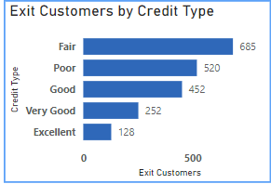
Exit Customers by Credit Type
Insight:
Customers with a "Fair" or "Poor" credit rating constitute the majority of exits (68.9%).
Customers with "Excellent" and "Very Good" ratings are least likely to leave.
How to Improve:
Add a financial analysis dimension, such as average account balance or loan status, to understand why lower credit types exit more.
Introduce predictive analytics to score at-risk customers based on credit type and churn history.

Slide 8
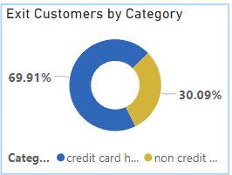
Exit Customers by Category
Insight:
69.91% of exiting customers were credit card holders, suggesting they face more churn risk compared to non-credit card holders (30.09%).
How to Improve:
Perform further segmentation of credit card holders (e.g., by spending habits or card type).
Include metrics for cross-selling other products (e.g., loans, savings accounts) to credit card holders to improve retention.

Slide 9
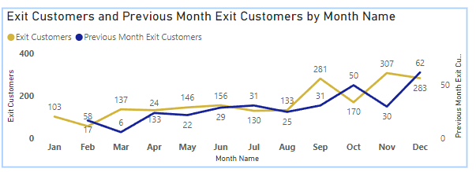
Exit Customers by month and previous month
Insight:
November experienced the highest churn (307), while February had the lowest (58).
The highest number of previous month exit customers is in November (283), followed by May (146).
A positive correlation exists between exit customers and previous month's exits.
How to Improve:
Investigate seasonal factors (e.g., holidays, tax season)
causing spikes in November churn.
Add annotations to highlight external events
(e.g., policy changes or interest rate hikes)
affecting churn.

Slide 10
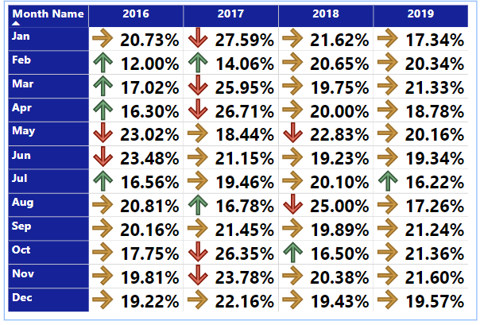
Churn % by year and months
Insight:
The highest churn percentage for any month is 27.59% (Jan 2017), while the lowest is 12.00% (Feb 2016).
2016 and 2017 had higher churn percentages in certain months compared to subsequent years like 2018 and 2019.
How to Improve:
Analyze customer feedback and transaction data during high churn months to identify common issues or dissatisfaction points.
Look for patterns such as service outages, product issues, or changes in pricing that might correlate with higher churn rates.

Slide 11
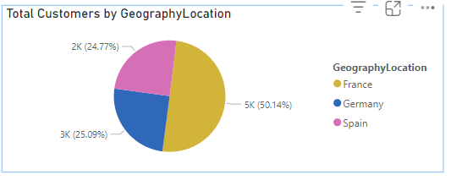
Customers by Geography location
Insight:
Most customers are from Germany (50.14%), followed by Spain (25.09%) and France (24.77%).
How to Improve:
Germany, as the largest market, should receive
targeted campaigns to further strengthen
customer loyalty.
Explore opportunities to increase the
customer base in France and Spain
through localized offers.

Slide 12
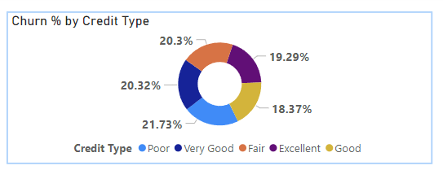
Churn % by Credit type
Insight:
The churn rate varies across credit types, with the highest churn in “Poor" (21.73%) and the lowest in “Good" (18.37%).
How to Improve:
Focus retention strategies on customers with
“Poor" and “Very Good" credit types, as they
exhibit higher churn rates.
Offer tailored loyalty programs or
incentives for these groups.

Slide 13
Strategies for customer retention.
Here are some effective strategies for customer retention:
Add dimensions such as customer complaints, transaction declines, or service issues to correlate with churn events.
Include data on retention strategies (e.g., customers retained after a churn warning call) to assess effectiveness.
To effectively target interventions, it's crucial to analyze churn rates at different stages of the customer lifecycle.
Identify customers who have become inactive and measure the rate at which they leave.
Investigate seasonal factors (e.g., holidays, tax season) causing spikes churn.

Slide 14

Thank you

